Slide 1

Objectives
In this session, you will learn to:
  Perform conditional formatting
  Use XPath pattern
  Present data in different formats
Notes:
Introduce the students to the course by asking them what they know about forensics. Next, ask the students what they know about system forensics and why is it required in organizations dependent on IT. This could be a brief discussion of about 5 minutes.
Lead the discussion to the objectives of this chapter.

Slide 2
Performing Conditional Formatting
Conditional formatting refers to the formatting of data based on a specific condition.
The two elements used for conditional formatting are:
  if
  choose
Notes:
Introduce the students to the different types of threats that systems face by:
Asking the students to give examples of what they think are environmental and human threats.
Asking the students to give instances of what they think are malicious and non-malicious threats.
Conclude the discussion on the different types of threats by giving additional examples of malicious and non malicious threats.

Slide 3
Performing Conditional Formatting (Contd.)
Conditional formatting refers to the formatting of data based on a specific condition.
The two elements used for conditional formatting are:
  if
  choose
  Provides an if-then construct.
  Follows the syntax:
  <xsl:if test="condition">
  [actions to be performed if the
  condition is true]
  </xsl:if>
Notes:
Introduce the students to the different types of threats that systems face by:
Asking the students to give examples of what they think are environmental and human threats.
Asking the students to give instances of what they think are malicious and non-malicious threats.
Conclude the discussion on the different types of threats by giving additional examples of malicious and non malicious threats.

Slide 4
Performing Conditional Formatting (Contd.)
Conditional formatting refers to the formatting of data based on a specified condition.
The two elements used for conditional formatting are:
  if
  choose
  Enables you to choose from two or more
  possible courses of action by testing multiple
  conditions.
  Follows the syntax:
  <xsl:choose>
  [action to be taken]
  </xsl:when>
  :
  :
  <xsl:otherwise>
  [action to be taken]
  </xsl:otherwise>
  </xsl:choose>
Notes:
Introduce the students to the different types of threats that systems face by:
Asking the students to give examples of what they think are environmental and human threats.
Asking the students to give instances of what they think are malicious and non-malicious threats.
Conclude the discussion on the different types of threats by giving additional examples of malicious and non malicious threats.

Slide 5
Identifying Comparison and Boolean Operators
Used with the if and choose elements to narrow down the formatting criteria.
The following table lists various comparison and Boolean operators.
Operator | Meaning | Example
Equal to
PRICE[. = 20]
PRODUCTNAME[. = ‘Mini Bus’]
=
PRICE[. != 20]
PRODUCTNAME[. != ‘Barbie Doll’]
!=
Not equal to
&lt;
Less than
PRICE[. &lt; 20]
&gt;
Greater than
PRICE[. &gt; 20]
&lt;=
Less than or equal to
PRICE[. &lt;= 20]
&gt;=
Greater than or equal to
PRICE[. &gt;= 20]
and
Logical AND
PRICE[. &gt 20 and . &lt; 30]
or
Logical OR
PRICE[. = 20 or . = 45]
not
Negation operator
PRICE[not(. = 30)]
Notes:
While explaining the definition of system forensics, ask the students to note the following key words in the definition:
Identify
Extract
Process
Analyze
Digital and hardware evidence
Tell the students that these form an integral aspect of system forensics and would be discussed in detail.
Before moving on to the next slide, hold a brief discussion on why is it important for organizations to take the help of system forensics. The discussion should be focused on:
The role that system forensics plays in organizations having an IT set up.
This discussion will serve as a precursor to the next slide.

Slide 6
Using XPath
XPath:
  Is used to search and retrieve information from an XML file.
  Treats an XML document as a tree of interrelated branches and nodes, as shown in the following figure.
PRODUCTDATA
PRODUCT
PRODID=“P001”
CATEGORY
=“TOY”
PRODUCTNAME
DESCRIPTION
PRICE
QOH
Mini Bus
This toy is for
children aged
4 and above
75
54
Notes:
While explaining the definition of system forensics, ask the students to note the following key words in the definition:
Identify
Extract
Process
Analyze
Digital and hardware evidence
Tell the students that these form an integral aspect of system forensics and would be discussed in detail.
Before moving on to the next slide, hold a brief discussion on why is it important for organizations to take the help of system forensics. The discussion should be focused on:
The role that system forensics plays in organizations having an IT set up.
This discussion will serve as a precursor to the next slide.

Slide 7
Describing XPath Expressions
XPath expressions can be used to retrieve data based on specific conditions.
XPath expressions identify the nodes in an XML document based on their names and values.
The following table lists the operators that can be used to create XPath expressions.
Operator/Special Character | Example | Description
/ | /PRODUCTDATA | Selects the immediate child elements of PRODUCTDATA. If this operator occurs at the start of the pattern, it indicates that the child elements should be selected from the root node.
// | //PRODUCTNAME | Searches for the specified element at any node level.
. | .PRODUCTNAME | Indicates the current context.
.. | ../PRODUCTNAME | Selects the PRODUCTNAME element, which exists within the parent of the current element.
* | * | Selects all elements.
Notes:
While explaining the definition of system forensics, ask the students to note the following key words in the definition:
Identify
Extract
Process
Analyze
Digital and hardware evidence
Tell the students that these form an integral aspect of system forensics and would be discussed in detail.
Before moving on to the next slide, hold a brief discussion on why is it important for organizations to take the help of system forensics. The discussion should be focused on:
The role that system forensics plays in organizations having an IT set up.
This discussion will serve as a precursor to the next slide.

Slide 8
Describing XPath Expressions (Contd.)
Operator/Special Character | Example | Description
@ | @PRODUCTID | Used as a prefix for the attribute.
@* | @* | Selects all attributes.
: | : | Separates the namespace prefix from the element or attribute name.
( ) | (PRICE*QUANTITY) | Used to group operations.
[ ] | [@PRODUCTID='P001'] | Applies a filter pattern.
+ | num1 + num2 | Returns the sum of two numbers.
- | num1 - num2 | Returns the difference of two numbers.
* | num1 * num2 | Returns the product of two numbers.
div | num1 div num2 | Returns the quotient of two numbers.
mod | num1 mod num2 | Returns the modulus, that is, the remainder of integer division.
Notes:
While explaining the definition of system forensics, ask the students to note the following key words in the definition:
Identify
Extract
Process
Analyze
Digital and hardware evidence
Tell the students that these form an integral aspect of system forensics and would be discussed in detail.
Before moving on to the next slide, hold a brief discussion on why is it important for organizations to take the help of system forensics. The discussion should be focused on:
The role that system forensics plays in organizations having an IT set up.
This discussion will serve as a precursor to the next slide.

Slide 9
Describing XPath Functions
XPath functions can be used to calculate and present data as a report.
The various categories of functions in XPath are:
  string: Used to perform string operations.
  node-set: Used to manipulate node-sets or to return information about them.
  Boolean: Used to evaluate an expression and return true or false.
  numeric: Used for numeric calculations.
Notes:
Elaborate on the role that system forensics plays in an organization, based on the discussion in the previous slide and the information given on this slide.

Slide 10
Demo: Using XPath Patterns in XSLT Style Sheets
Problem Statement:
  The executive at CyberShoppe needs to display the
  product-wise order report. The product and order data is stored in an XML document. This data includes product details, such as product ID, name, and price per unit. For each product, the details about all the orders placed against that product are also stored in the document. The order details include the order number, shipping address, total quantity ordered and the order value. The total sales value for each product also needs to be displayed.
Notes:
While explaining the definition of system forensics, ask the students to note the following key words in the definition:
Identify
Extract
Process
Analyze
Digital and hardware evidence
Tell the students that these form an integral aspect of system forensics and would be discussed in detail.
Before moving on to the next slide, hold a brief discussion on why is it important for organizations to take the help of system forensics. The discussion should be focused on:
The role that system forensics plays in organizations having an IT set up.
This discussion will serve as a precursor to the next slide.

Slide 11
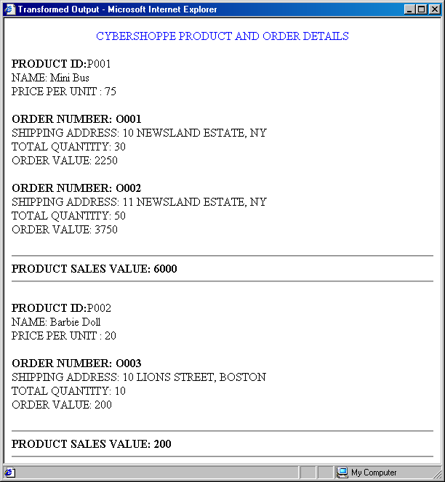
Demo: Using XPath Patterns in XSLT Style Sheets (Contd.)
Problem Statement (Contd.):
  The following figure illustrates the data display format.
Notes:
While explaining the definition of system forensics, ask the students to note the following key words in the definition:
Identify
Extract
Process
Analyze
Digital and hardware evidence
Tell the students that these form an integral aspect of system forensics and would be discussed in detail.
Before moving on to the next slide, hold a brief discussion on why is it important for organizations to take the help of system forensics. The discussion should be focused on:
The role that system forensics plays in organizations having an IT set up.
This discussion will serve as a precursor to the next slide.

Slide 12
Demo: Using XPath Patterns in XSLT Style Sheets (Contd.)
Problem Statement (Contd.):
  The following figure displays the structure of the corresponding XML document.
SUMMARY
PRODUCT
ORDER
SHIPPING
ADDRESS
QUANTITY
Notes:
While explaining the definition of system forensics, ask the students to note the following key words in the definition:
Identify
Extract
Process
Analyze
Digital and hardware evidence
Tell the students that these form an integral aspect of system forensics and would be discussed in detail.
Before moving on to the next slide, hold a brief discussion on why is it important for organizations to take the help of system forensics. The discussion should be focused on:
The role that system forensics plays in organizations having an IT set up.
This discussion will serve as a precursor to the next slide.

Slide 13
Demo: Creating a Style Sheet Using an XSLT Editor
Problem Statement:
  The employee information of an organization is stored in the file employee.xml. The data stored in this file is as follows:
    <?xml version="1.0"?>
    <EMPDETAILS>
    <EMP EMPID="E001">
    <ENAME>Karen</ENAME>
    <DESG>MANAGER</DESG>
    <DEPT>SALES</DEPT>
    <SALARY>250</SALARY>
    </EMP>
    <EMP EMPID="E002">
    <ENAME>George</ENAME>
    <DESG>Executive</DESG>
    <DEPT>ACCOUNTS</DEPT>
    <SALARY>300</SALARY>
Notes:
While explaining the definition of system forensics, ask the students to note the following key words in the definition:
Identify
Extract
Process
Analyze
Digital and hardware evidence
Tell the students that these form an integral aspect of system forensics and would be discussed in detail.
Before moving on to the next slide, hold a brief discussion on why is it important for organizations to take the help of system forensics. The discussion should be focused on:
The role that system forensics plays in organizations having an IT set up.
This discussion will serve as a precursor to the next slide.

Slide 14
Demo: Creating a Style Sheet Using an XSLT Editor (Contd.)
Problem Statement (Contd.):
    </EMP>
    <EMP EMPID="E003">
    <ENAME>Steve</ENAME>
    <DESG>Manager</DESG>
    <DEPT>FINANCE</DEPT>
    <SALARY>320</SALARY>
    </EMP>
    <EMP EMPID="E004">
    <ENAME>Ricky</ENAME>
    <DESG>Clerk</DESG>
    <DEPT>SALES</DEPT>
    <SALARY>150</SALARY>
    </EMP>
Notes:
While explaining the definition of system forensics, ask the students to note the following key words in the definition:
Identify
Extract
Process
Analyze
Digital and hardware evidence
Tell the students that these form an integral aspect of system forensics and would be discussed in detail.
Before moving on to the next slide, hold a brief discussion on why is it important for organizations to take the help of system forensics. The discussion should be focused on:
The role that system forensics plays in organizations having an IT set up.
This discussion will serve as a precursor to the next slide.

Slide 15
Demo: Creating a Style Sheet Using an XSLT Editor (Contd.)
Problem Statement (Contd.):
    <EMP EMPID="E005">
    <ENAME>Richard</ENAME>
    <DESG>Divisional Manager</DESG>
    <DEPT>MARKETING</DEPT>
    <SALARY>375</SALARY>
    </EMP>
    </EMPDETAILS>
  Display the name, designation, and department of the employees earning higher than $250 in green and the rest in red. You need to display the details as a bulleted list. Create the style sheet using an XSLT editor.
Notes:
While explaining the definition of system forensics, ask the students to note the following key words in the definition:
Identify
Extract
Process
Analyze
Digital and hardware evidence
Tell the students that these form an integral aspect of system forensics and would be discussed in detail.
Before moving on to the next slide, hold a brief discussion on why is it important for organizations to take the help of system forensics. The discussion should be focused on:
The role that system forensics plays in organizations having an IT set up.
This discussion will serve as a precursor to the next slide.

Slide 16
Displaying Data in a Tabular Format
The features of HTML and XSLT can be combined to format the data from an XML document for appropriate display.
The HTML code can be embedded in an XSLT document to display the data.
Notes:
While explaining the definition of system forensics, ask the students to note the following key words in the definition:
Identify
Extract
Process
Analyze
Digital and hardware evidence
Tell the students that these form an integral aspect of system forensics and would be discussed in detail.
Before moving on to the next slide, hold a brief discussion on why is it important for organizations to take the help of system forensics. The discussion should be focused on:
The role that system forensics plays in organizations having an IT set up.
This discussion will serve as a precursor to the next slide.

Slide 17
Displaying Data in a Tabular Format (Contd.)
The following table lists the HTML elements that are required to display data in a tabular format.
HTML Tag | Description
TABLE | Acts as a container for all other tags used to specify the appearance of data in a table. It has attributes, such as border, background color, cellpadding, cellspacing, and width that enable you to specify the appearance of the table.
THEAD | Used to specify headings for a table.
TBODY | Used as a parent for the TR and TD elements.
TR | Used to represent a row in a table. This tag acts as a container for the TH and TD elements.
TH | Used to add column headings.
TD | Used to specify the data to be displayed in columns.
Notes:
While explaining the definition of system forensics, ask the students to note the following key words in the definition:
Identify
Extract
Process
Analyze
Digital and hardware evidence
Tell the students that these form an integral aspect of system forensics and would be discussed in detail.
Before moving on to the next slide, hold a brief discussion on why is it important for organizations to take the help of system forensics. The discussion should be focused on:
The role that system forensics plays in organizations having an IT set up.
This discussion will serve as a precursor to the next slide.

Slide 18
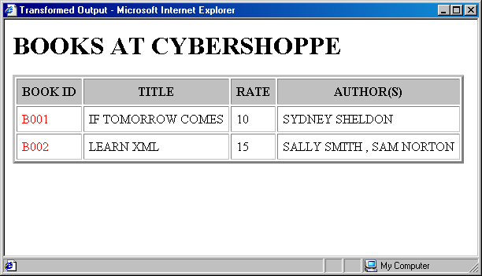
Demo: Displaying Data in a Table
Problem Statement:
  The details about the books that are available for sale at CyberShoppe are stored in an XML document. The book details, such as book ID, title, rate, author first name, and author last name should be displayed in a table. The first and last names of the author should be displayed in a single column, AUTHOR(S). If a book has multiple authors, their names should be displayed as comma‑separated values. The following figure shows a sample output.
Notes:
While explaining the definition of system forensics, ask the students to note the following key words in the definition:
Identify
Extract
Process
Analyze
Digital and hardware evidence
Tell the students that these form an integral aspect of system forensics and would be discussed in detail.
Before moving on to the next slide, hold a brief discussion on why is it important for organizations to take the help of system forensics. The discussion should be focused on:
The role that system forensics plays in organizations having an IT set up.
This discussion will serve as a precursor to the next slide.

Slide 19
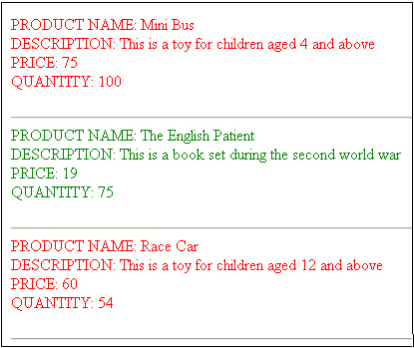
Exercises
Problem Statement:
  The list of products sold at CyberShoppe needs to be displayed. These products need to be categorized based on their prices, with products priced higher than $50 displayed in red and the rest in green. The product name, description, price, and quantity on hand of each product should be displayed, as shown in the following figure.
  The product.xml file will be provided to you.
Notes:
While explaining the definition of system forensics, ask the students to note the following key words in the definition:
Identify
Extract
Process
Analyze
Digital and hardware evidence
Tell the students that these form an integral aspect of system forensics and would be discussed in detail.
Before moving on to the next slide, hold a brief discussion on why is it important for organizations to take the help of system forensics. The discussion should be focused on:
The role that system forensics plays in organizations having an IT set up.
This discussion will serve as a precursor to the next slide.

Slide 20
Practice Questions
You need to display the details of all employees whose salary is equal to $1200. The salary of an employee is represented using the SALARY element in an XML document. Which of the following statements will you use to filter the employee data based on the specified criterion?
  a. <xsl:if test=“SALARY[. = 1200]”>
  b. <xsl:if test=“SALARY[. = ‘1200’] />
  c. <xsl:if select=“SALARY[. = ‘1200’]”>
  d. <xsl:if match=“SALARY[. = 1200]”>
Answer:
  a. <xsl:if test=”SALARY[. = 1200]”>
Notes:
Reiterate the concepts taught earlier by asking the given question.

Slide 21
Practice Questions
What will the following XPath expression return?
starts-with(“Hello World”, “world”)
  a. 0
  b. True
  c. False
  d. 7
Answer:
  c. False
Notes:
Reiterate the concepts taught earlier by asking the given question.

Slide 22
Practice Questions
What will the following XPath expression return?
sum(100 + 200)
  a. 300
  b. NaN
  c. The expression will result in an error.
  d. Null
Answer:
  c. The expression will result in an error.
Notes:
Reiterate the concepts taught earlier by asking the given question.

Slide 23
Practice Questions
Consider the following statements:
Statement A: XPath treats an XML document as a tree of inter-related branches and nodes.
Statement B: A node can be of any type, such as an element, attribute, processing instruction (PI), comment, text, or namespace.
Which of the following is correct about the preceding statements?
  a. Statement A is True, and Statement B is False.
  b. Statement A is False, and Statement B is True.
  c. Both, Statement A and Statement B, are True.
  d. Both, Statement A and Statement B, are False.
Answer:
  c. Both, Statement A and Statement B, are True.
Notes:
Reiterate the concepts taught earlier by asking the given question.

Slide 24
Practice Questions
Which one of the following statements will you use to display the value of an attribute named partno?
  a. <xsl:text select=“partno”/>
  b. <xsl:value-of select= “@partno” />
  c. <xsl:value-of select= “partno” />
  d. <xsl:value-of select= “@partno” >
Answer:
  b. <xsl:value-of select= “@partno” />
Notes:
Reiterate the concepts taught earlier by asking the given question.

Slide 25
Summary
In this session, you learned that:
  The if and choose elements in XSLT allow you to format data based on a condition.
  The if element provides a simple if-then construct. It has a single test attribute, which specifies the criteria for performing an action.
  The choose element selects one element from a number of possible alternatives. It consists of a number of when elements, followed by an optional otherwise element.
  The XPath language is used to search and retrieve information from an XML document.
  The primary purpose of XPath is to address parts of an XML document, and manipulate strings, numbers, and Boolean values.

Slide 26
Summary (Contd.)
  XPath expressions can match specific patterns, retrieve results, and perform additional operations relative to the context of the returned nodes.
  XPath provides the following types of functions:
    string: Used for basic string operations, such as finding the length of a string or changing a string from uppercase to lowercase.
    node-set: Used to manipulate node sets or return information about node sets.
    Boolean: Used to return either true or false based on the argument passed to it.
    numeric: Used to perform calculations on numeric values.
  The HTML code in an XSLT style sheet is used to display data in different formats.
  The import element is used to import one XSLT style sheet to another XSLT style sheet.

